Slide 1

THE DAILY DOSE OF CAFFEINE APPLICATION
Awaken me caffeine
BY.. HANANEE DALOR

Slide 2
INTRODUCTIONS
The daily dose of caffeine application is a project that calculates the amount of caffeine contained in coffee, tea, and another drinks with ingredient based of cocoa and chocolate-based, and these beverages can be divided into three categories: hot, cold, frappe.
This application helps in managing projects in various fields, including Record daily drinking data of users , Informing and displaying information when users drink too much . Consumers or users will be more aware and more healthy

Slide 3
PROBLEM STATEMENT
Consumers are not aware of health issues.
There is an increase in coffee drinking every year, but consumer still lack knowledge of caffeine contained in beverages.
There is no application with the notification function showing the amount of caffeine that should be received.

Slide 4
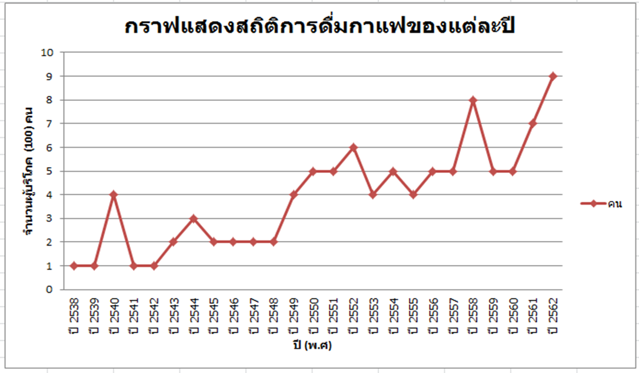
THE RESULTS FROM ONLINE QUESTIONNAIRE
Source:https://docs.google.com/forms/d/1QvzA7zjrQbw_DsmSzE0r5v-vzJFna5dp92cKyntNupo/edit#responses

Slide 5
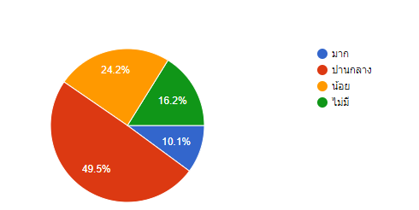
ข้อมูลแสดงความรู้เรื่องคาเฟอีนของคนในพื้นที่
Source:https://docs.google.com/forms/d/1QvzA7zjrQbw_DsmSzE0r5v- vzJFna5dp92cKyntNupo/edit#responses

Slide 6
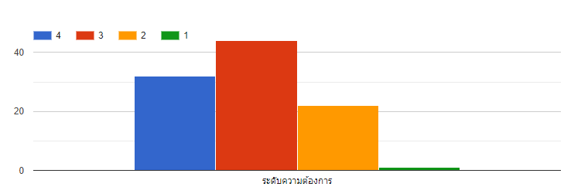
ข้อมูลแสดงความอยากรู้เรื่องปริมาณคาเฟอีนของแต่ละเครื่องดื่ม
Source:https://docs.google.com/forms/d/1QvzA7zjrQbw_DsmSzE0r5v-vzJFna5dp92cKyntNupo/edit#responses

Slide 7
OBJECTIVE
To develop calculate caffeine application of user or consumer who drink caffeine
To show symbol when consumer overdue.
To show graphs of drinkers and summarized as a daily, weekly and monthly graph.

Slide 8
PROJECT SCOPE
The proposed of this application was created for all consumer or user who drink beverage containing caffeine.
This application will calculate three types of beverages such as hot drinks, cold drinks and frappe drinks .
This application which will calculate from standard cup of drinks and specific the menu of coffee, tea menus and others drink which has ingredient of cocoa such as cocoa, milo,ovaltine and chocolate etc.

Slide 9
SIGNIFICANT OF STUDY
To help user manage drinks comfortable and properly by using application.
To increase knowledge of drinkers or consumer.
To be an application that shows data and records drinking information of users.

Slide 10







TOOLS OF USED

Slide 11
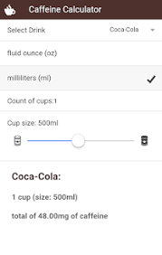
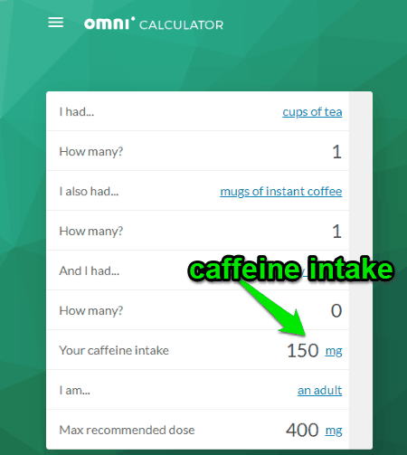
CHAPTER 2 LITERATURE REVIEW
Caffeine Calculator
Omni calculator

Slide 12
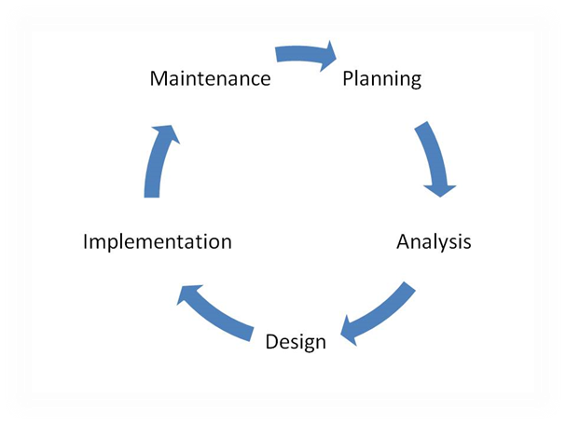
CHAPTER 3 METHODOLOGY
The software development life cycle(SDLC)
The SDLC Model

Slide 13
PHASES IN THE PROCESS
Planning - Identify the problem of the project such as
determine the scope of project, find problem statement, define project objective and etc.
Analysis -Requirement gathering by using Google Form
for creating online questionnaire.
Design – Create or design the format of the application.
Implementation - Build application or coding.
Maintenance -Repairing and continue the application.

Slide 14
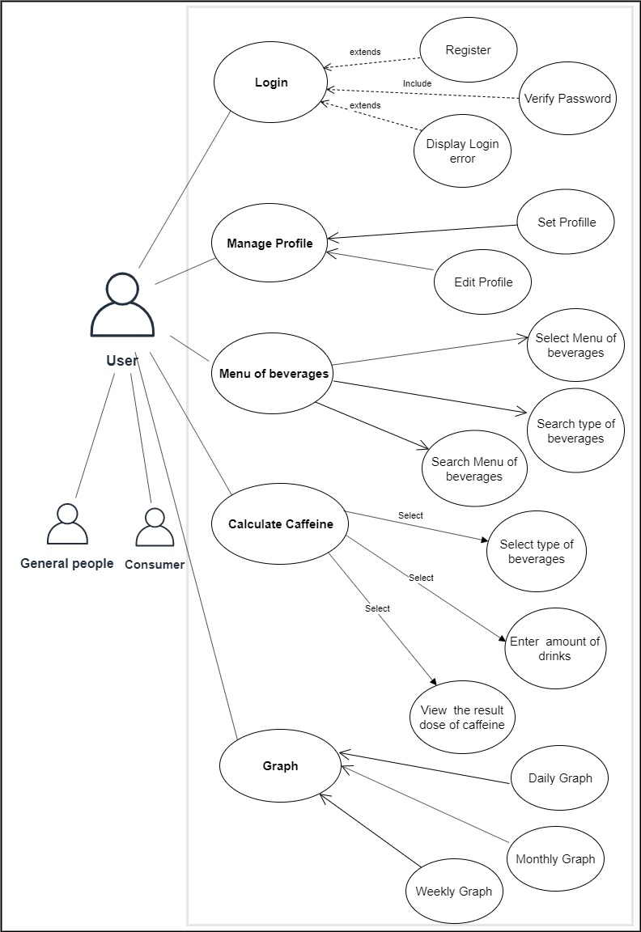
USE CASE DIAGRAM
The use case diagram used to presentation of the user’s interaction with the system

Slide 15
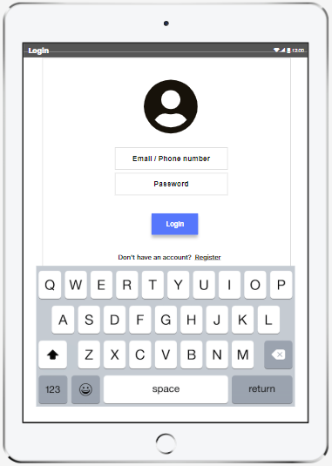
USER INTERFACE DESIGN
The login page that requested for user e-mail and user password for login the application.

Slide 16
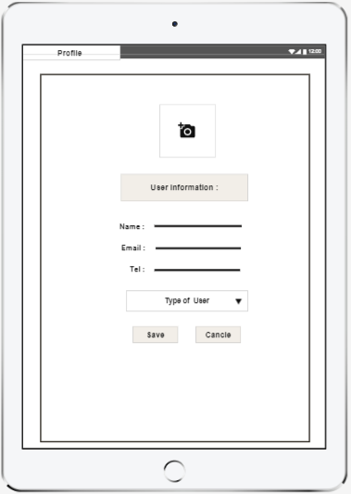
PROFILE PAGE
The profile page that included the information of user; image, name, e-mail, phone, and select type or status of consumer. User able to change any information then click on save button to save the information or click on cancel button if do not edit the information.

Slide 17
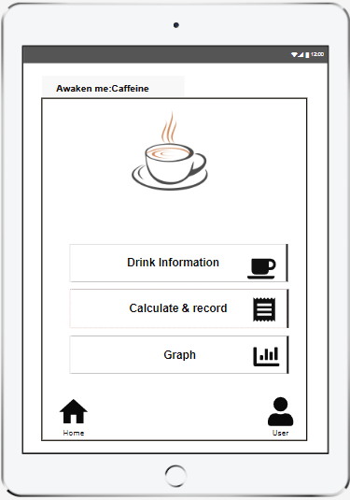
HOME PAGE
The home page included three buttons for functions working. User able to select any functions then click the link to go to another page.

Slide 18
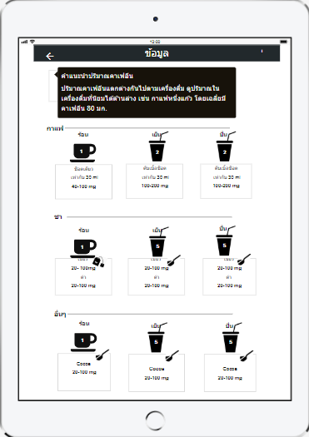
SETTING PAGE
This page included information on the calculation of caffeine in beverages for functions working and information of cups.

Slide 19
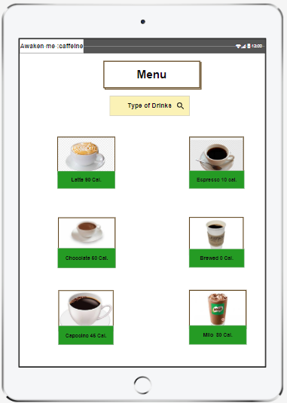
MENU PAGE
The drinks page included many to buttons for functions working. User able to select and searching by typing any drink menu then clicks the link to go to another page.

Slide 20
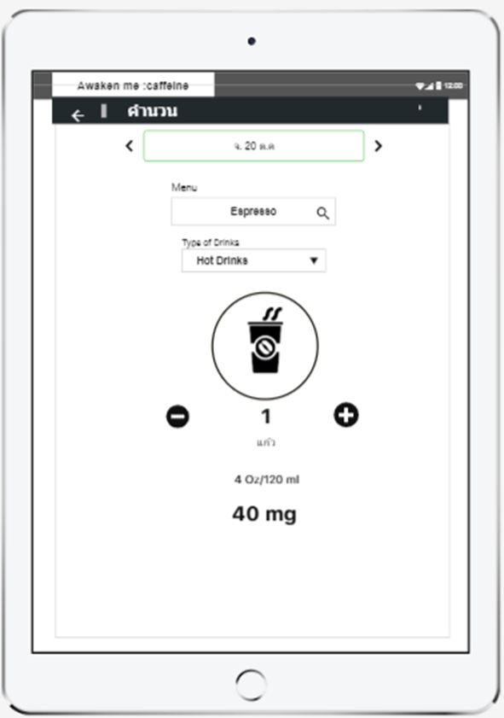
CALCULATE PAGE
The calculate page of hot drink of 4 oz. that included button for press the number. User can view the result of caffeine then click the link to go to another page.

Slide 21
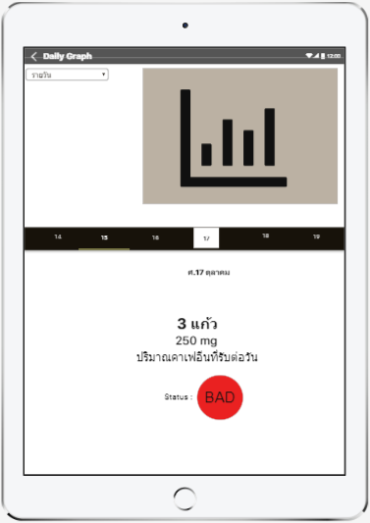
GRAPH PAGE
The daily graph page included information such as graph, number of glasses. User can view the result of caffeine then click the link to go to another page.

Slide 22
SUMMARY
The development process in which are including Planning, Analysis, Design, Implementation and Maintenance. The output of planning phase is the project feasibility or proposal. The output of analysis phase is the analyze results from all data collection. The output of design phase is the list of requirement, Use case diagrams and user interfaces designing. The output of implementation phase is the database designing and coding this project. The output of maintenance phase is carrying the system from development into testing, solving and feedback. The main point of the daily dose of caffeine application is focused on user or consumers who like to drink coffee and want to know how much their body should receive per day.

